Slide 1
ENGR90037 CAPSTONE
People management
Lecture 7
Yimin & Bagus

Slide 2
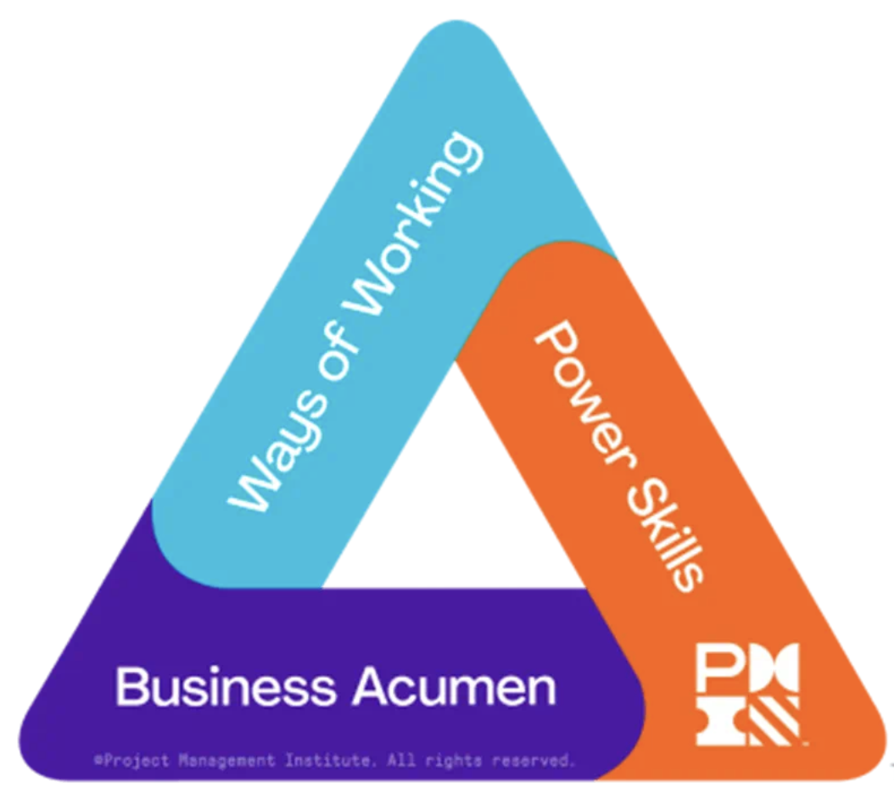
The PMI Talent Triangle
Interpersonal skills: collaborative leadership, communication, empathy.
Variety of frameworks and techniques to choose from, for predictive or agile projects.
Understanding the broader organisational and market landscape. Includes financial literacy, strategic alignment, and data-driven decision-making.
ENGR90037 Capstone · Lecture 7: Managing People
1

Slide 3
From managing the project to managing people
• Managing the project is deliverable-oriented — you can point at what is finished
• Managing people is process-oriented — there is no deliverable, only how you work
• This is not a psychology course. It is an introductory lecture on people management
• We will not cover every aspect, and we will not go deep on any one of them
ENGR90037 Capstone · Lecture 7: Managing People
2

Slide 4
Manager and leader are two different jobs
• A manager copes with complexity — plans, budgets, schedules, controls
• A leader copes with change — direction, alignment, motivation
• "Managers do things right. Leaders do the right thing" ― Warren G. Bennis
• As project manager of your capstone, you are doing both jobs at once
ENGR90037 Capstone · Lecture 7: Managing People
3

Slide 5
The more uncertain the project, the more leadership matters
• A routine project with a known method needs mostly management
• An uncertain project needs leadership to hold direction while the method is unclear
• Software design, a research project, a novel prototype: the plan changes weekly, and sometime client does not know what exactly do they want
• COVID was the extreme case: no precedent, no method, decisions required daily
ENGR90037 Capstone · Lecture 7: Managing People
4

Slide 6
The paradoxes a project manager faces
• Innovate and stability — encourage new ideas without breaking the plan
• Big picture and detail — zoom out to steer, zoom in to check
• individuals and team — encourage individuals and stress the team
• These are not problems to solve. They are tensions to hold
ENGR90037 Capstone · Lecture 7: Managing People
5

Slide 7
The Eisenhower method
• Evaluate every task on two axes: important / unimportant and urgent / not urgent
• Not important and not urgent → delete
• Not important but urgent → delegate
• Important and not urgent → decide. Given an end date
• Important and urgent → do immediately, and personally
Urgent
Not urgent
Do immediately and personally
Decide
Important
Delegate
Delete
Not important
ENGR90037 Capstone · Lecture 7: Managing People
6

Slide 8
The Eisenhower method
Urgent
Not urgent
1. Assignment 2 is due;
2. Booking the equipment for your prototype.
1. Writing your final report;
2. Backing up your experiment data
3. Planning your career
Important
Picking up the printed parts from the lab
Collecting the availability for next stakeholder meeting
Updating your social media profile
Checking if your assignment grade is released or not
Not important
ENGR90037 Capstone · Lecture 7: Managing People
7

Slide 9


First things first — Covey’s jar
• Rocks are the big tasks, gravel the small ones, the jar is your energy
Big tasks
Your energy
Small tasks
ENGR90037 Capstone · Lecture 7: Managing People
8

Slide 10
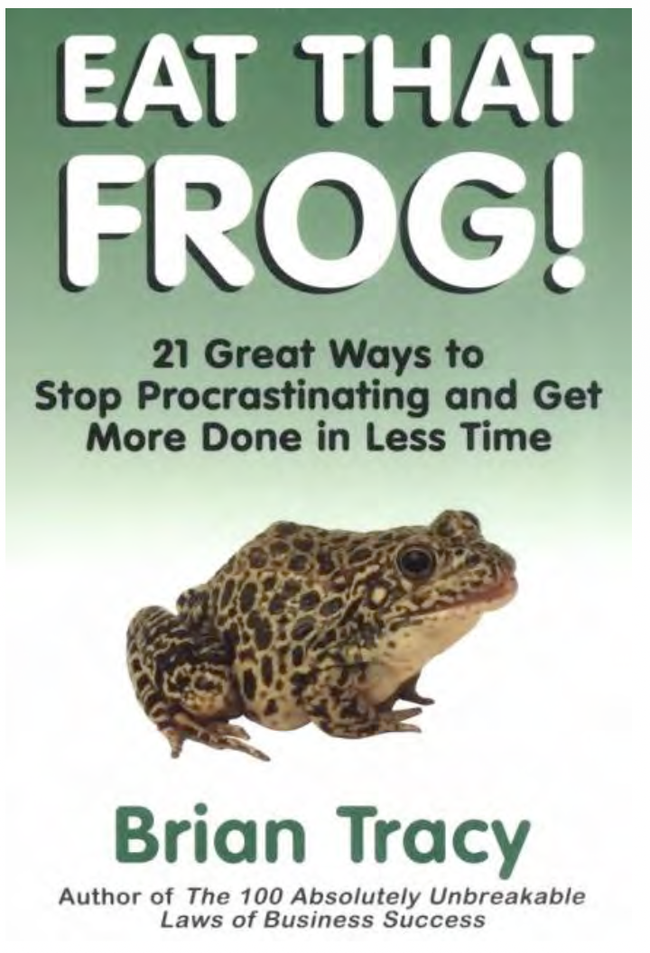
First things first — Eat that frog
"If it's your job to eat a frog, it's best to do it first thing in the morning. And if it's your job to eat two frogs, it's best to eat the biggest one first."
ENGR90037 Capstone · Lecture 7: Managing People
9

Slide 11
Personal development — strengths and weaknesses
• Two separate projects: build on a strength, and address a weakness
• They are not the same work and they do not pay off the same way
• A strength improves fastest — you are already good and you enjoy it
• A weakness rarely becomes a strength. The goal is to stop it costing you
• First problem: most people cannot name their own strengths accurately
ENGR90037 Capstone · Lecture 7: Managing People
10

Slide 12
Indicators of a strength
• Yearning — you are drawn to it before anyone asks you to do it
• Timelessness — you look up and two hours are gone
• Satisfaction — finishing it feels good
• Rapid learning — you picked it up faster than the people around you
• Glimpses of excellence — moments where you were clearly better than competent
ENGR90037 Capstone · Lecture 7: Managing People
11

Slide 13
Your strengths — a self-assessment
• Two axes: task-oriented or people-oriented, vision-oriented or execution-oriented
• Download the spreadsheet from LMS, complete it, and mark where you sit
• Do this at your next team meeting — put it on the agenda
• Mark all four of you on the same chart.
People
Execution
Vision
Task
ENGR90037 Capstone · Lecture 7: Managing People
12

Slide 14
Blind spots, and working on a weakness
• Your blind spot is by definition invisible to you, and obvious to everyone else
• The only cheap source of information is other people. Ask, and do not argue with it
• Then: practice. A weakness improves the same way anything else does — repetition
• Pick one that is costing the team something now
• "I am bad at public speaking" and your oral exam is in six weeks.
ENGR90037 Capstone · Lecture 7: Managing People
13

Slide 15
Motivation
• Motivation is what makes somebody do a thing they were not otherwise going to do
• Two questions, not one: how do I motivate myself, and how do I motivate others
• You cannot motivate anyone with what motivates you — not everyone wants the same thing
• So the first job is to find out what the other person actually wants
ENGR90037 Capstone · Lecture 7: Managing People
14

Slide 16
Human motivation — five things people want
• Fame — prestige, reputation, recognition. To be known for something
• Fortune — money, and how much of it is enough
• Power — freedom to choose, influence over others, authority
• Love — a person, a family, a community, a country. Something outside yourself
• Just being me — self-image. Acting against it costs more than any of the above
ENGR90037 Capstone · Lecture 7: Managing People
15

Slide 17
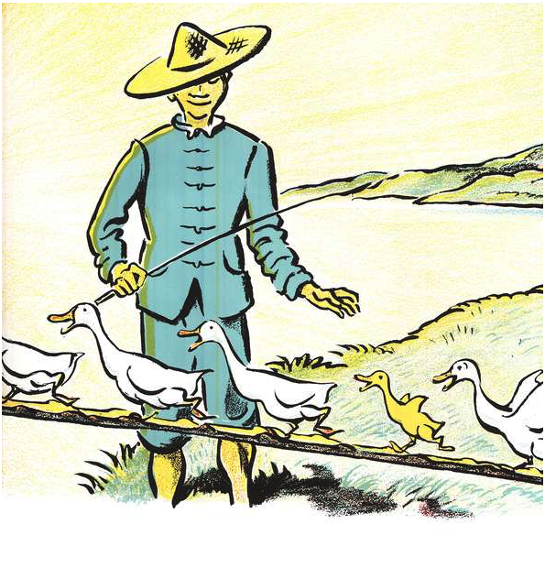
Motivating a team — “carrot” and “sticks”
Ping, the duck, lives on a boat on the River. Every day he and his duck family are taken by their owner to feed on the riverbank.
Later, when it is evening, quickly they would march, one by one, up over the little bridge and on to the boat which was their home on the River
Ping was always careful, very very careful not to be the last, because the last duck to cross the bridge always got a spank on the back
What about an alternative: the first duck into the boat gets a snail
ENGR90037 Capstone · Lecture 7: Managing People
16

Slide 18
Motivating a team — rewards and punishments
• The carrot motivates you to be the best. The stick motivates you not to be the worst
• They are not interchangeable. They buy completely different behaviour
• Want the single best result? Use a “carrot”. Run a competition and winner takes all
• Want a minimum standard met by everyone? Use a “stick”. Set a floor, and enforce it
• Either way the consequence must be real, proportionate and announced in advance
ENGR90037 Capstone · Lecture 7: Managing People
17

Slide 19
What do these consequences motivate?
1. The best project wins $1000
2. All members of the team with the worst project fail
3. The least productive member of every team fails
4. Every project rated acceptable wins $1000
18

Slide 20
Team pitfalls — groupthink
• A team becomes cohesive, and cohesion starts to cost more than it buys
• Illusion of invulnerability — "we have got this"
• Self-censorship — the doubt you have but do not raise, because the mood is good
• Lack of critical thinking. The group pretend they have explored other alternatives
ENGR90037 Capstone · Lecture 7: Managing People
19

Slide 21
Team pitfalls — Bureaucratic bypass syndrome
• The team routes around the organisation's procedures to get things done
• It works at first. That is exactly what makes it attractive
• The cost is goodwill: the people you bypassed stop helping when you need them
• It can undermine all of the policies and procedures that keep the company together if bypassing becomes habitual
ENGR90037 Capstone · Lecture 7: Managing People
20

Slide 22
Team pitfalls — Going native
• The team adopts the client's interests and loses sight of its own organisation's
• It begins as commitment to the customer like a virtue.
• Symptom: agreeing to every new request without asking what it costs your project
ENGR90037 Capstone · Lecture 7: Managing People
21

Slide 23
Team pitfalls — Team spirit becomes team infatuation
• Members obsess over the challenge and peer talent, ignoring external reality.
• intense high-performance project focus mimics romantic obsession
• The team feels like an "us vs. the world" couple, shutting down outside perspective
• Exhaustion hits hard once the project milestone passes.
• Re-entry into normal organizational life feels flat
ENGR90037 Capstone · Lecture 7: Managing People
22

Slide 24
This week, in your own team
• Do the self-assessment and compare all four answers. Put it on the agenda
• Name the gap in your team's pattern, and decide who covers it
• Agree how you will handle an underperforming member, before you need to
ENGR90037 Capstone · Lecture 7: Managing People
23

Slide 25
References
Larson, E. W., & Gray, C. F. (2024). *Project management: The managerial process* (9th ed.). McGraw-Hill. — leadership, the paradoxes, and the four team pitfalls.
Tracy, B. (2017). Eat that frog! (3rd ed.). Berrett-Koehler.
Project Management Institute. (2015). *Guidelines for undergraduate project management curricula and resources* (Vol. III: PM-2, Project teams, leadership and communication). Newtown Square, PA: PMI.
Warfield, R. (2025). *Motivation* (PM_09) and lecture materials. ENGR90037, University of Melbourne, LMS.
ENGR90037 Capstone · Lecture 7: Managing People
24

